Slide 1
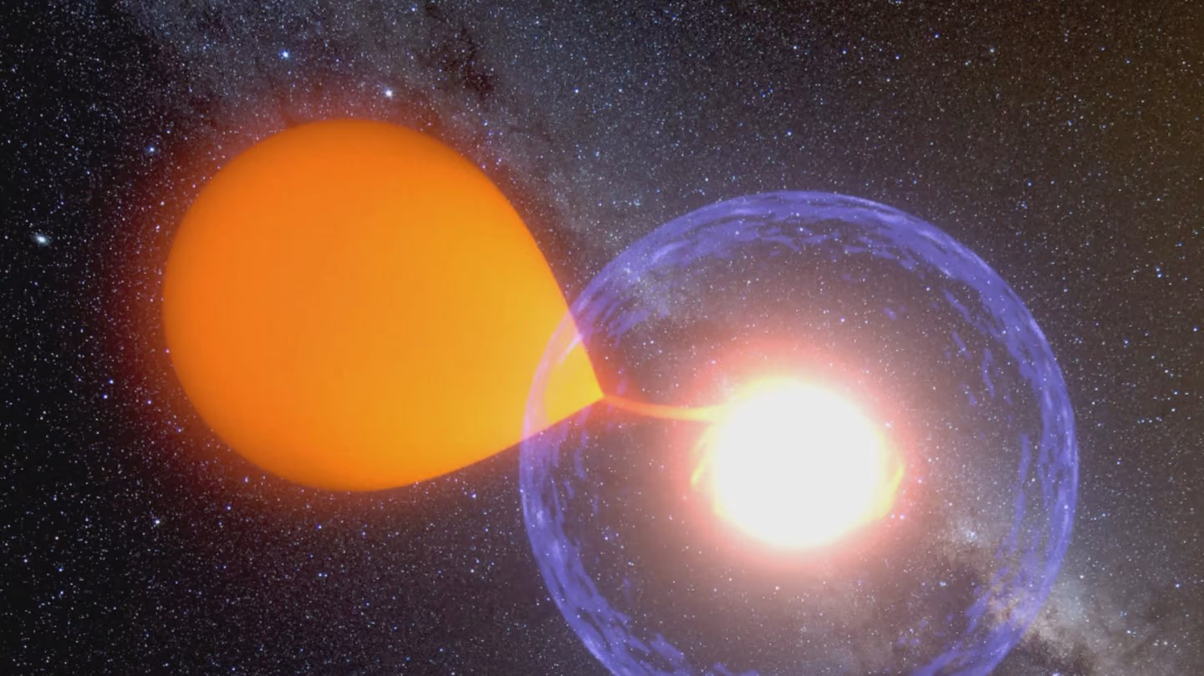
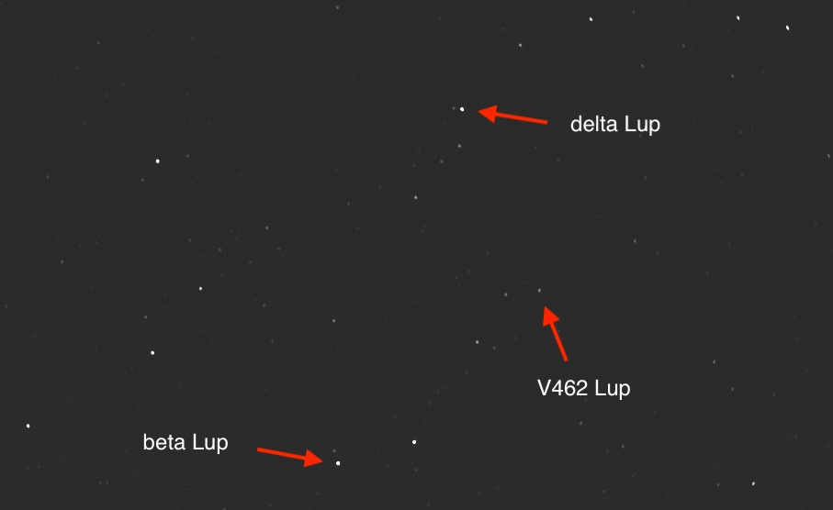
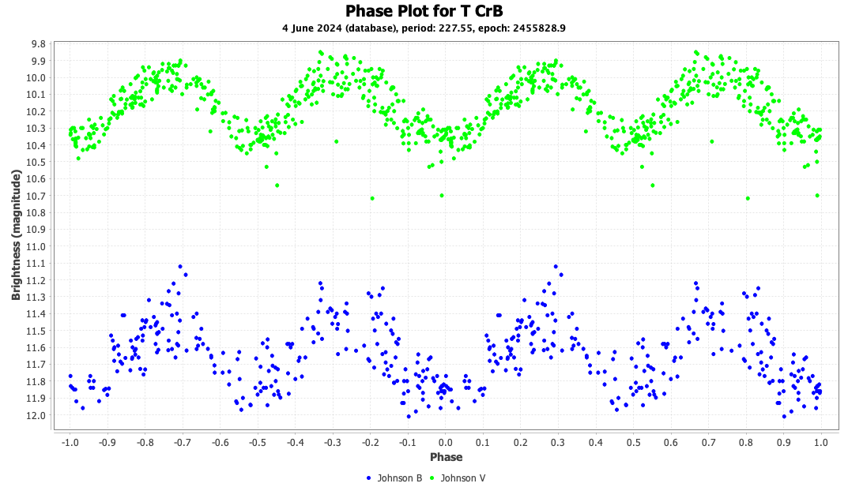
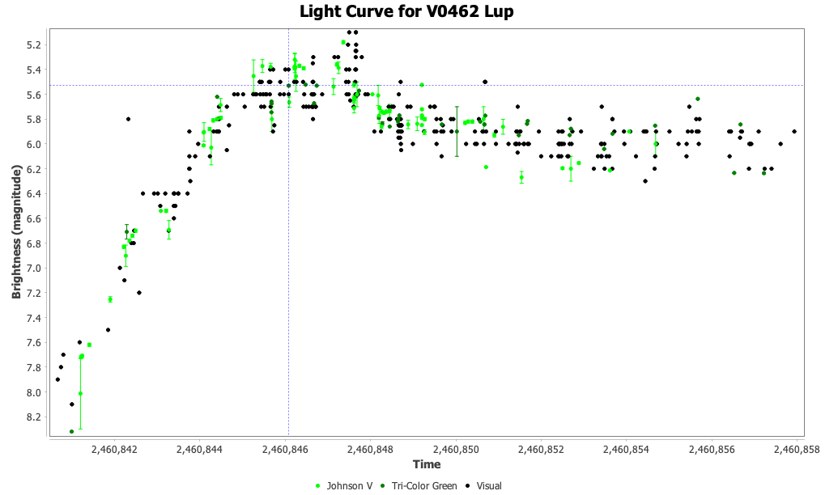
https://newatlas.com/star-system-hibernation-nova/44994/​
Nova update
T CrB, V462 Lup, V572 Vel
David benn
Astronomical society of South AUSTRALIA (ASSA)
American association Of variable star OBSERVERS (AAVSO)
July 2025

Slide 2
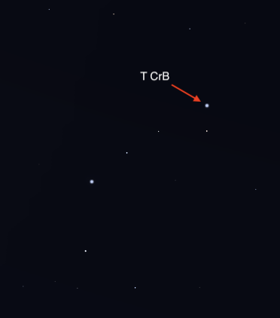
I was here talking about T CrB in June last year, and again in September
I'd like to be able to give an update on T CrB post-eruption​...​
But we're still waiting!
(that star above is fake news)

Slide 3
September 14 2024
Another talk about T CrB
"We’re still waiting, and we’re about to lose it in the early evening sky.
I’ve been checking the area with binoculars most clear nights and doing some photometry with my Seestar S50.
Even if we miss the main event, we have another shot at seeing the nova rise about 100 days post-eruption."
https://strangequark.me/2024/09/14/another-talk-about-t-crb/

Slide 4
February 22 2025
Observing T CrB again
"I started observing the constellation of Corona Borealis (CrB) again this week, in preparation for the recurrent nova T CrB (aka The Blaze Star) to erupt.
This was the first time I’ve done so since early October 2024, when the constellation left Adelaide’s evening sky."
https://strangequark.me/2025/02/22/observing-t-crb-again/
February 9 was 79th anniversary of 1946 outburst

Slide 5
April 22 2025
Another T CrB update (still waiting)
"I’ve been observing the constellation Corona Borealis (CrB) as often as possible since late February at around 5 or 6am.
With CrB gradually becoming observable earlier, if I’m still awake at 1am (fairly often), I can observe it (with binoculars) before I go to bed now."
https://strangequark.me/2025/04/22/another-t-crb-update-still-waiting/

Slide 6
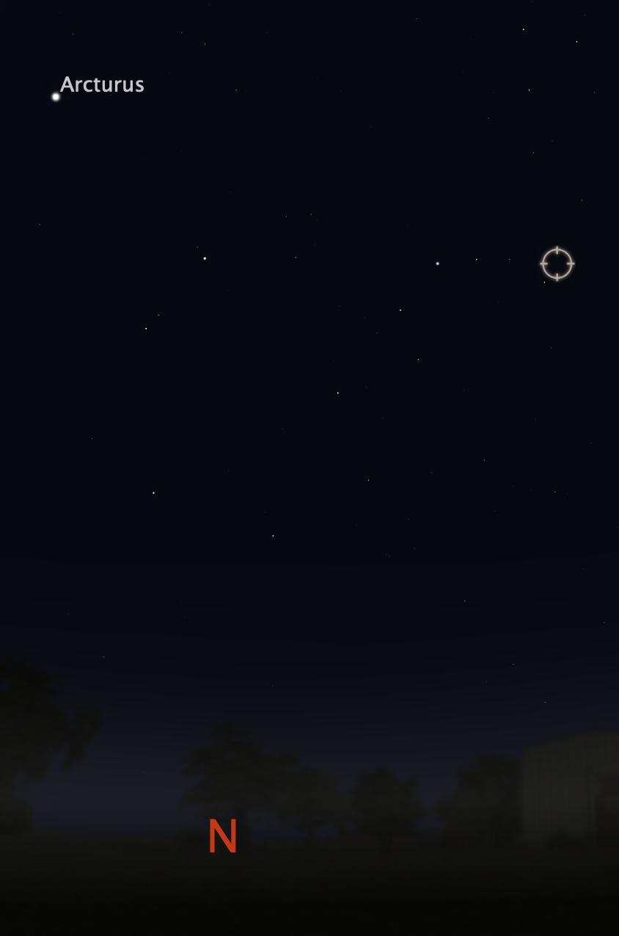
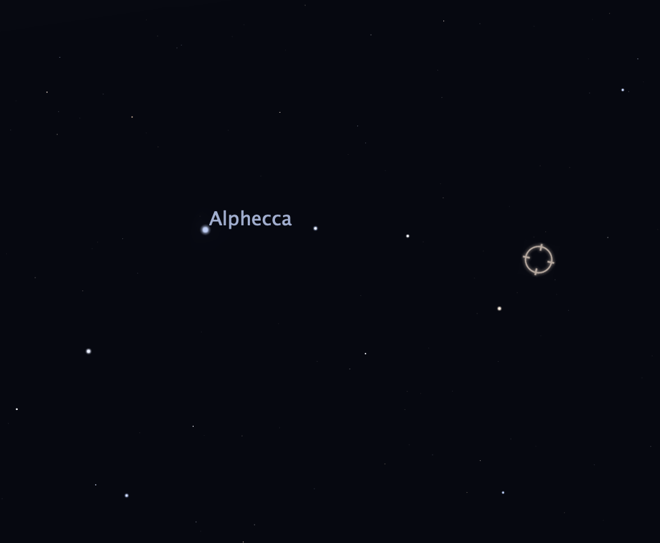
~9pm June/July

Slide 7
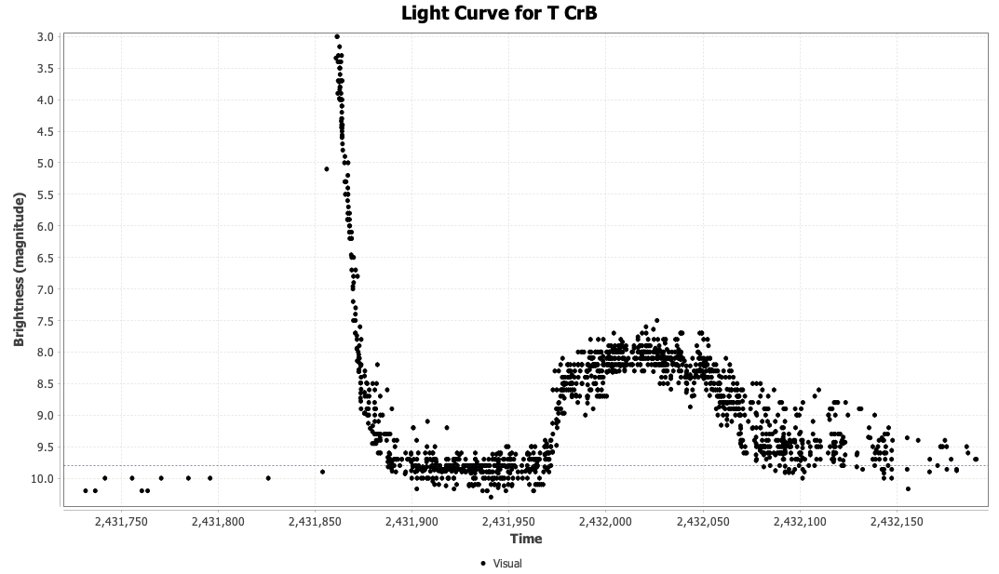
By comparison with 1946 brightening...
We are (roughly) here!

Slide 8
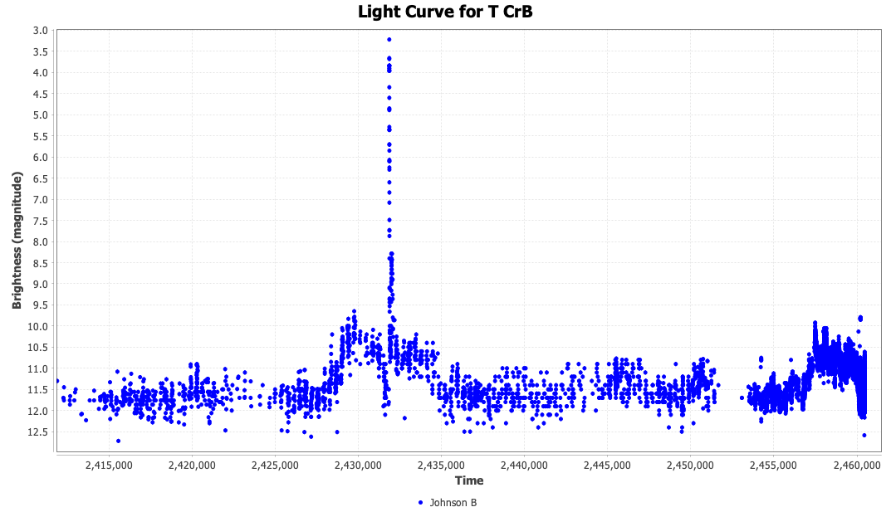
Magnitude rose about 10 years before 1946 eruption.
Latest rise started late 2014 / early 2015.
Magnitude dipped 1 year before 1946 eruption.
Current dip started March/April 2023.
Magnitude changes not identical, but similar.
Most obvious in B vs V data.

Slide 9
Spectral changes detected in early 2025 by researchers in Germany observed sharp increase in emission lines, suggesting substantial rise in accretion rate onto white dwarf component, a potential precursor to nova eruption. (ATel #17030)
Others (Schaefer and Kloppenborg) countered that the link between increased emission line strength and imminence of eruption is unclear (poorly predictive).
https://www.aavso.org/blog/tcrb-blazed-and-confused

Slide 10
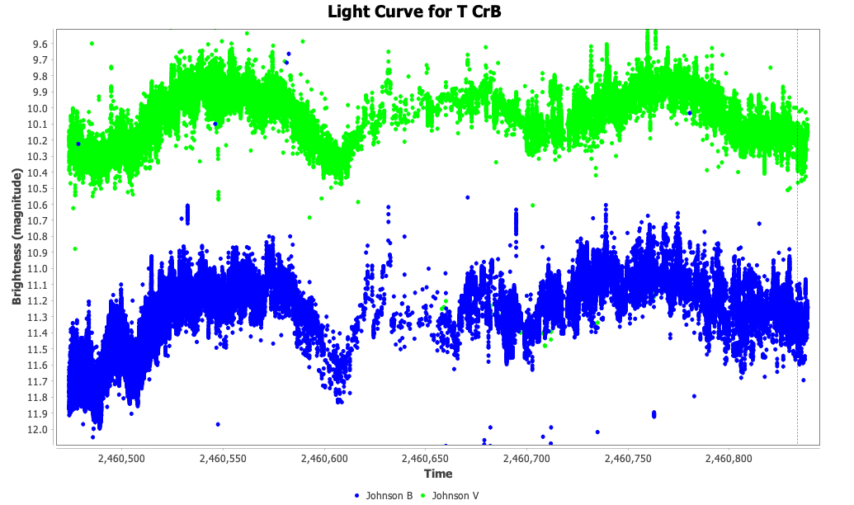
Anyway, this is the light curve from June 2024 to June 2025...

Slide 11
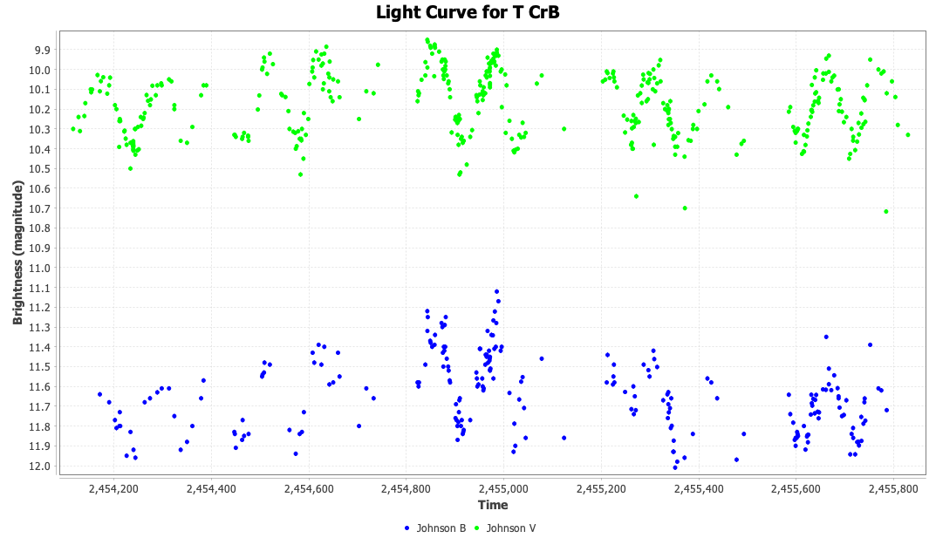
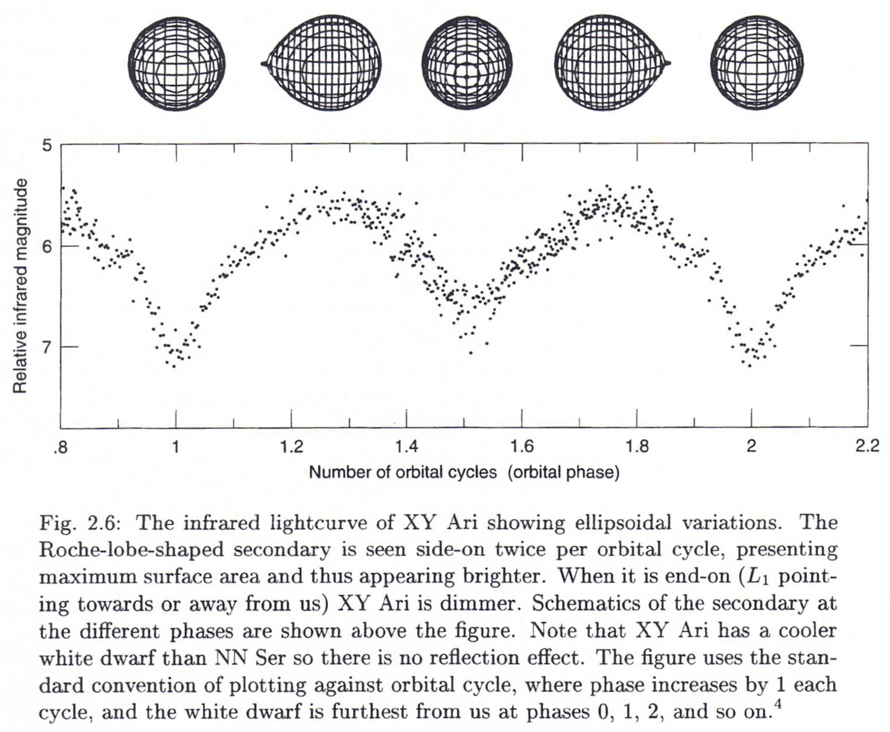
"Folding" data onto 227.55 period gives phase plot
source: Hellier, Cataclysmic Variables: How and Why they Vary

Slide 12
In "When will the Next T CrB Eruption Occur?" Jean Schneider (October 2024) writes:
"By going more carefully into the dates of occurrence of the past eruptions, one finds that the successive events date separations are an integer multiple of the orbital revolution period..."
"...the eruptions are not strictly periodic, but...were all separated by an integer multiple of the orbital period 227.5687 days."
"From that, I tentatively infer that the eruption date after 1946 February 9 should be 2431861 + N*227.5687 where N is an integer close to 128, if the orbital period remains constant."
https://iopscience.iop.org/article/10.3847/2515-5172/ad8bba

Slide 13
Led to predictions for T CrB eruption of:
  March 27 2025, Nov 10 2025 or June 25 2026
Popular press latched onto article and suggested greater certainty than was warranted.
The first of these dates has passed with no nova eruption.
We will see about November!
Note that the author of this Research Notes of the AAS article said in the abstract that: The
  "The investigation is based on the combination of the previous eruption dates and on the orbital ephemeris of the binary system, without any hypothesis on the eruption mechanism."

Slide 14
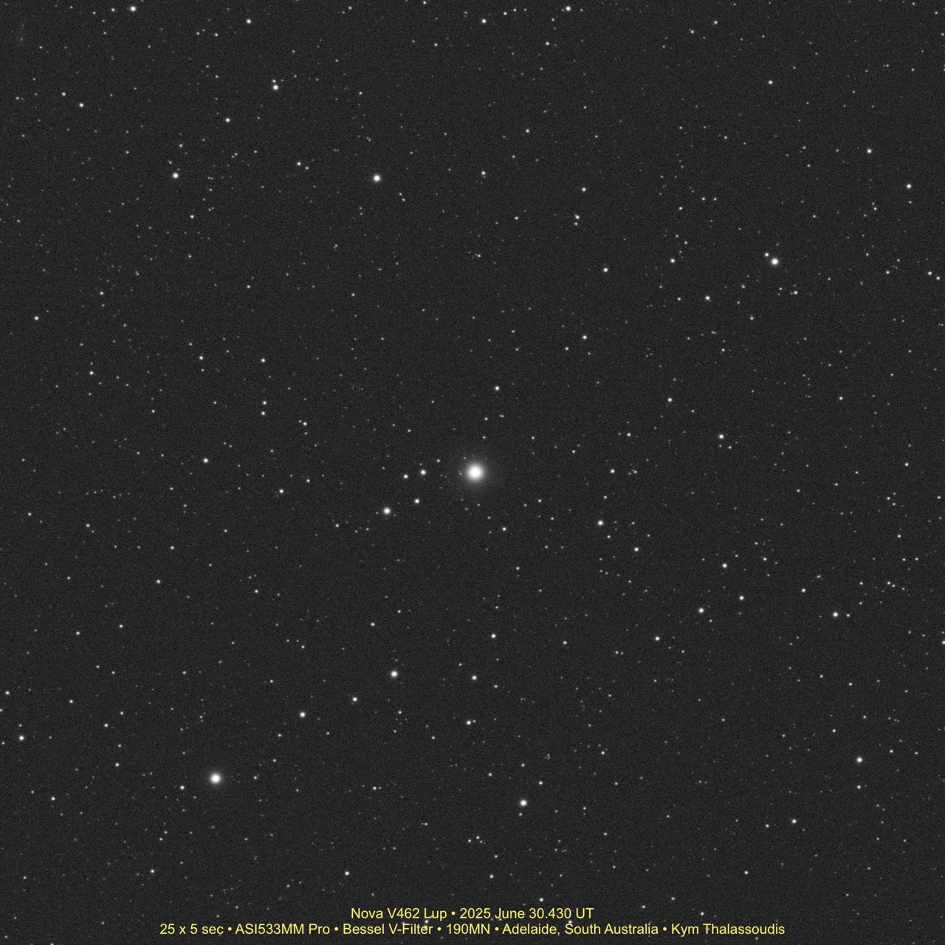

Slide 16
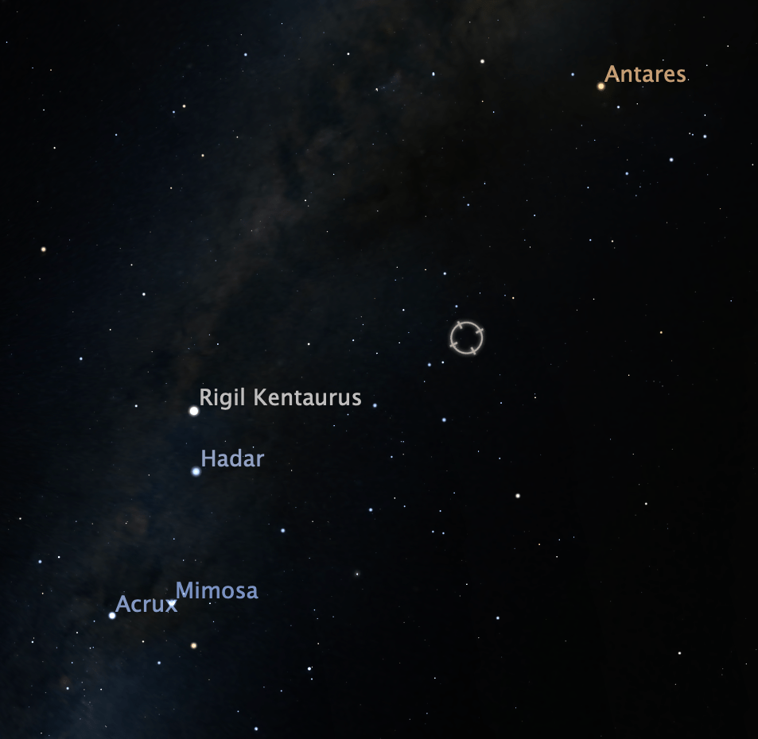
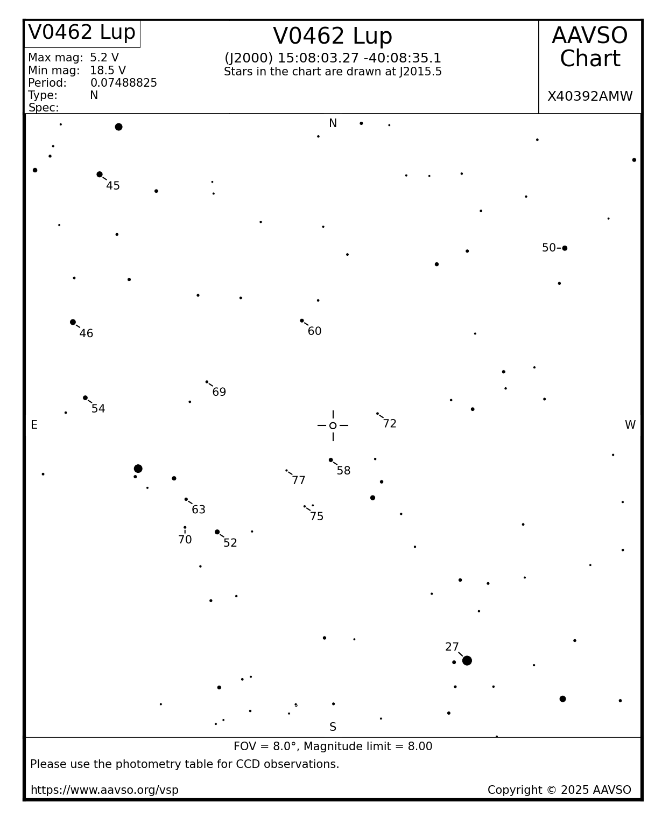
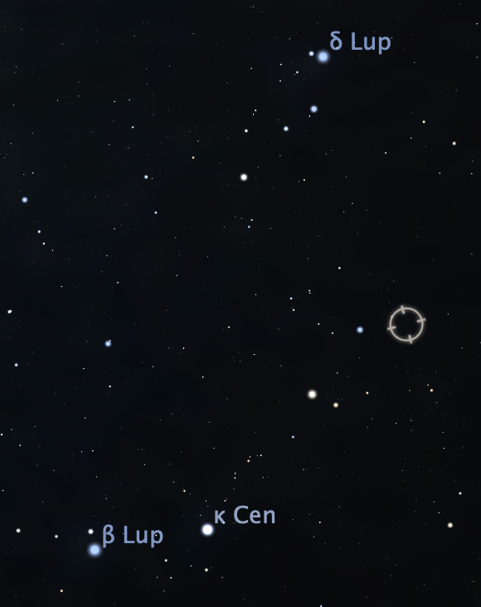

Slide 17
V462 Lup
Discovered on June 12 by the ASAS-SN* survey at magnitude 8.7.
  *All Sky Automated Survey for SuperNovae
Peaked at around magnitude 5.1.
"...a smooth observed rise taking more than 6 days. This is an ordinary...nova, while the pre-eruption counterpart appears as an isolated blue star for which Gaia gives G=18.34.
...periodicity is coherent across the data from 2019.35 to 2023.35. The folded light curve appears as a simple sinewave...period is 1.797 hours. This periodicity is coherent and stable over 4.0 years, so it must be the orbital period." (ATel #17240)

Slide 18
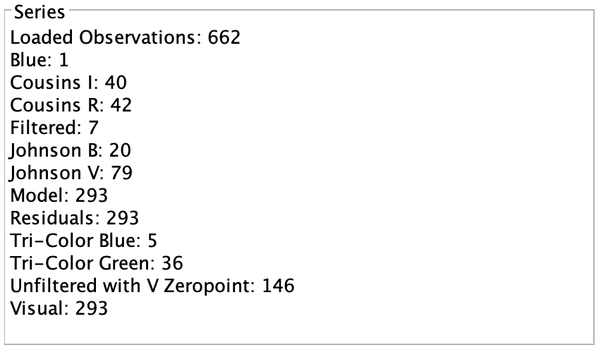
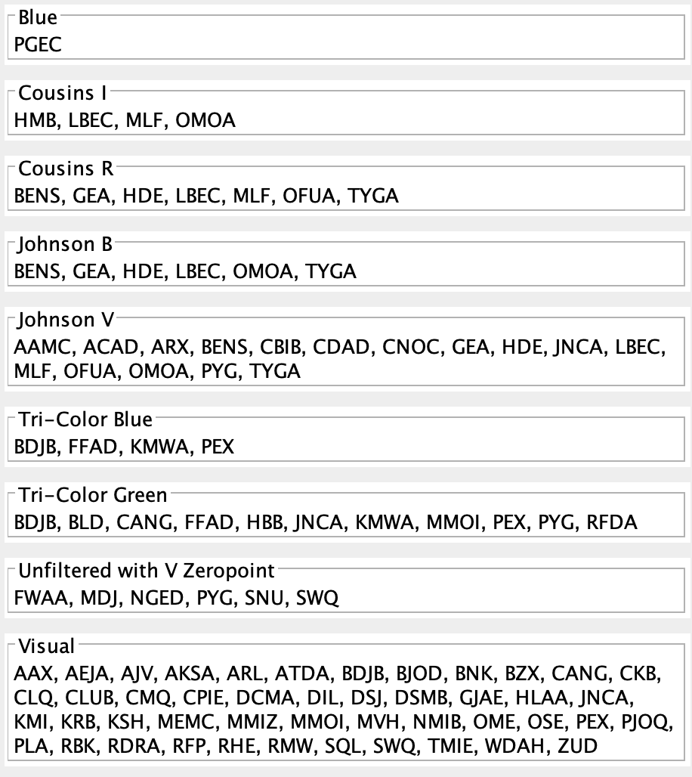

Slide 19
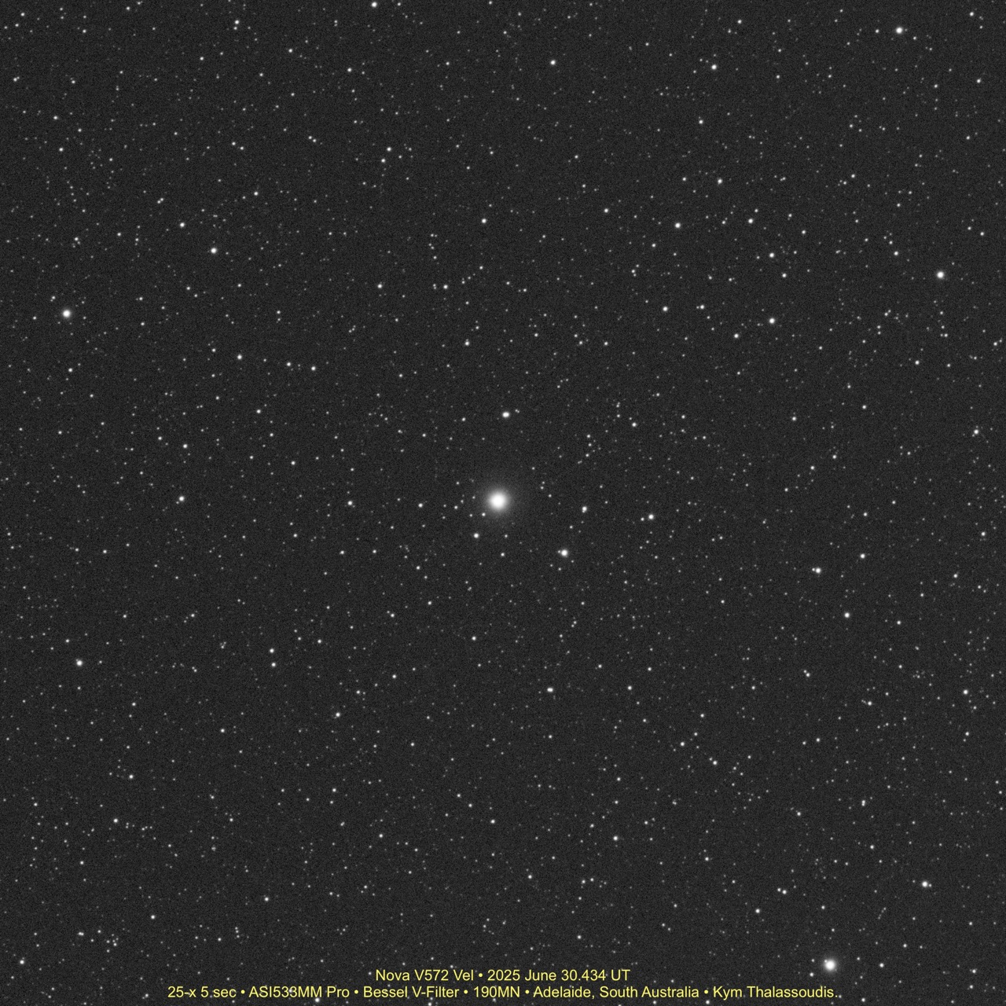

Slide 20
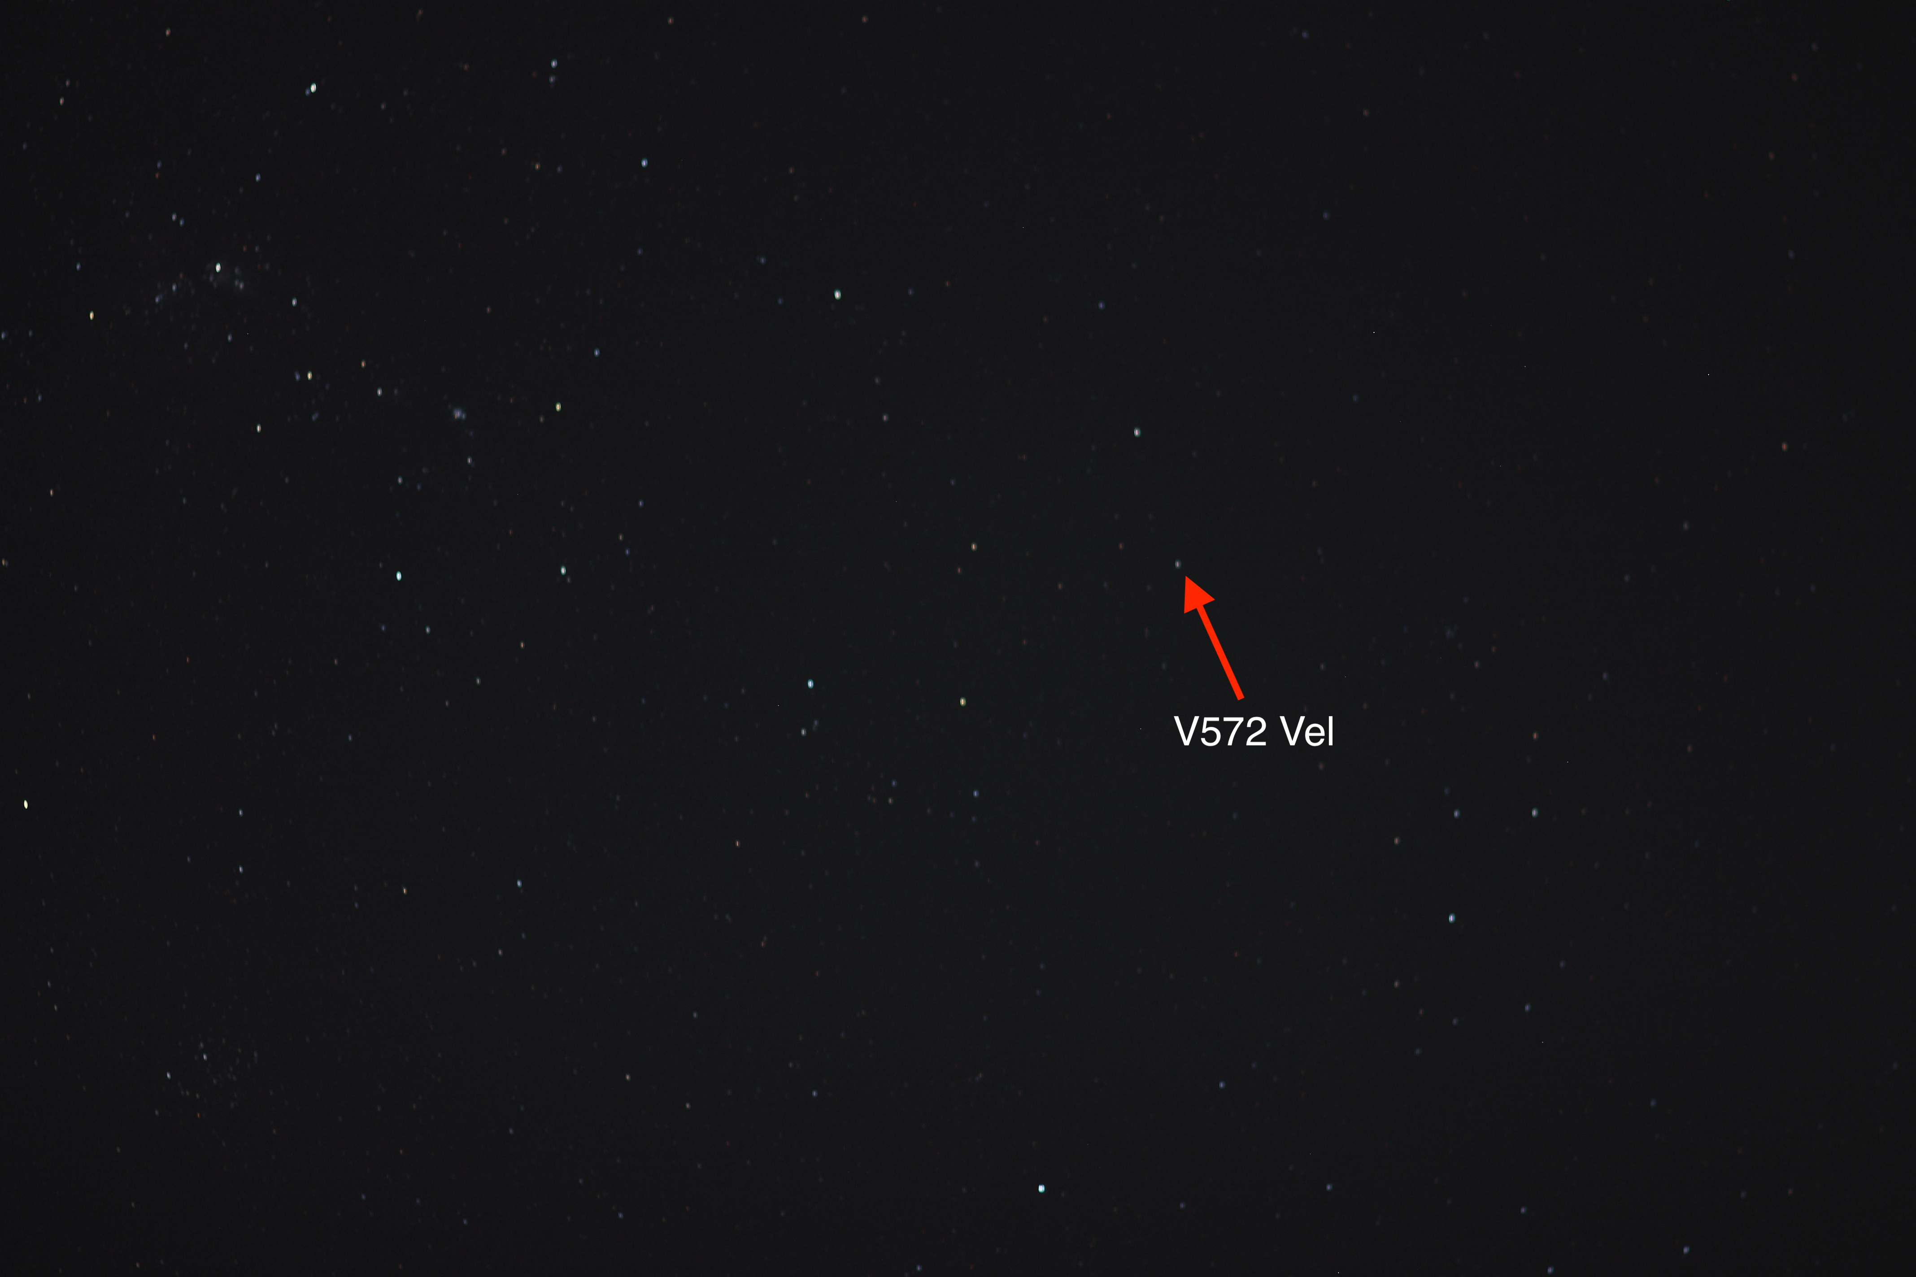

Slide 21
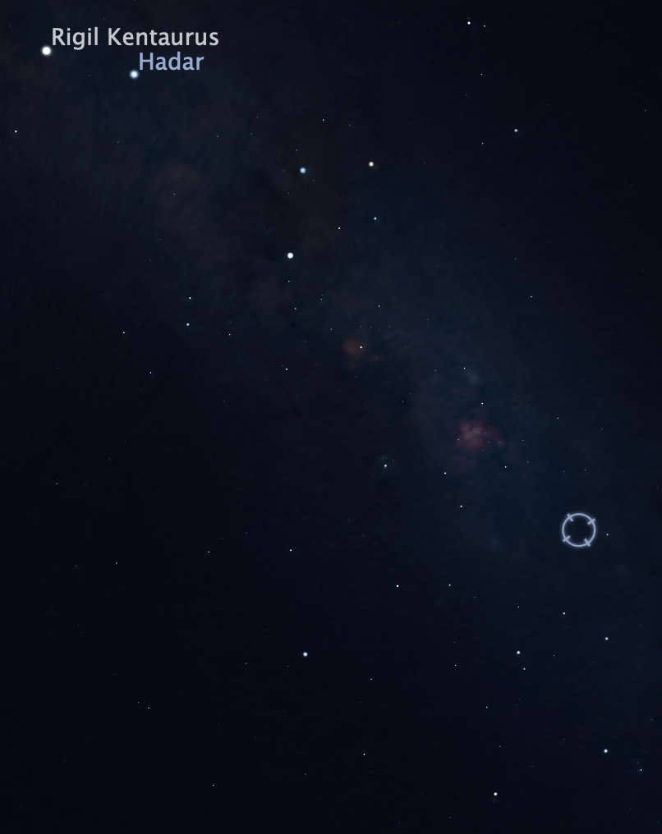
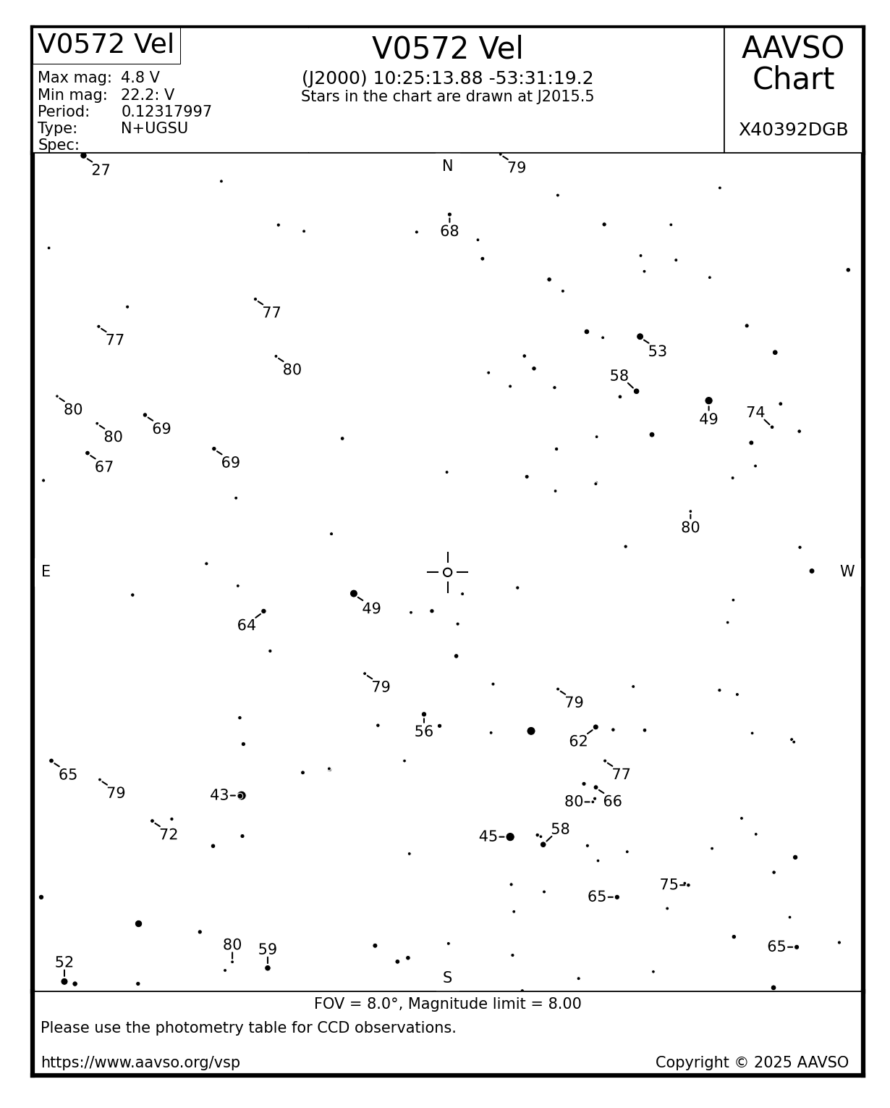

Slide 22
PNV J10251200-533110 (V572 Vel)
John Seach (NSW) discovered at magnitude 5.7, and Andrew Pearce (WA) independently found it (magnitude 5.5) on June 25.
Reached magnitude 4.8 but has been quite "messy".
AAVSO observing campaign reported progenitor star as likely being a 22.2 blue star with large amplitude variability.
"Fermi Gamma-ray Space Telescope observations...indicates a gamma-ray excess consistent with the optical position " (ATel# 17252)

Slide 23
PNV J10251200-533110 (V572 Vel)
"Optical spectroscopy of V572 Vel: Not obviously a classical nova" (ATel #17252)
"OGLE Pre-Eruption Observations of V572 Velorum Reveal Dwarf Nova Outbursts" (ATel #17253)
  "...archival OGLE observations reveal...multiple outbursts during the years 2017-2024, indicating its classification as a dwarf nova. We tentatively classify it as an SU UMa-type object due to the presence of both long...and short...outbursts."
Classification: N+UGSU
  N=Nova
  UGSU=SU UMa-type dwarf nova (UG=U Geminorum type)

Slide 24
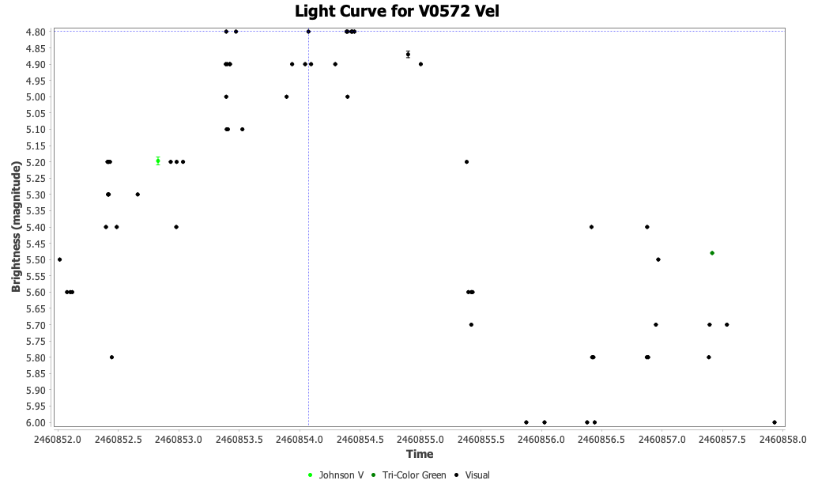
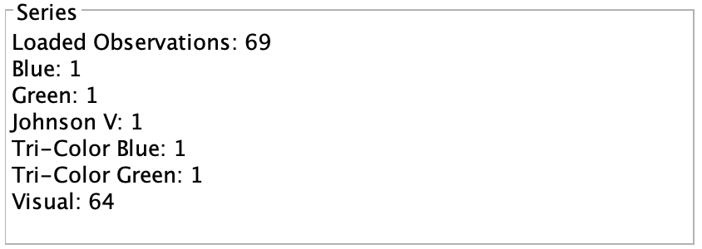
Need more observations!

